Slide 1
AI-Based PID Auto-Tuning Using Machine Learning and AWS
Harpreet Singh
011 932 084

Slide 2
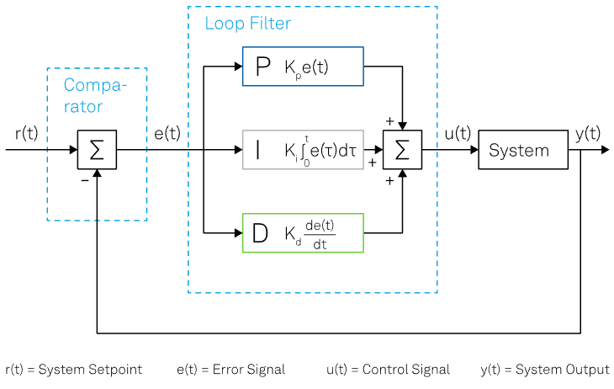
PID Control System Diagram

Slide 3
Problem Statement
Traditional PID controllers require manual tuning
Poor tuning causes overshoot and oscillations
Industrial systems change over time
Machine learning can automatically tune PID parameters

Slide 4
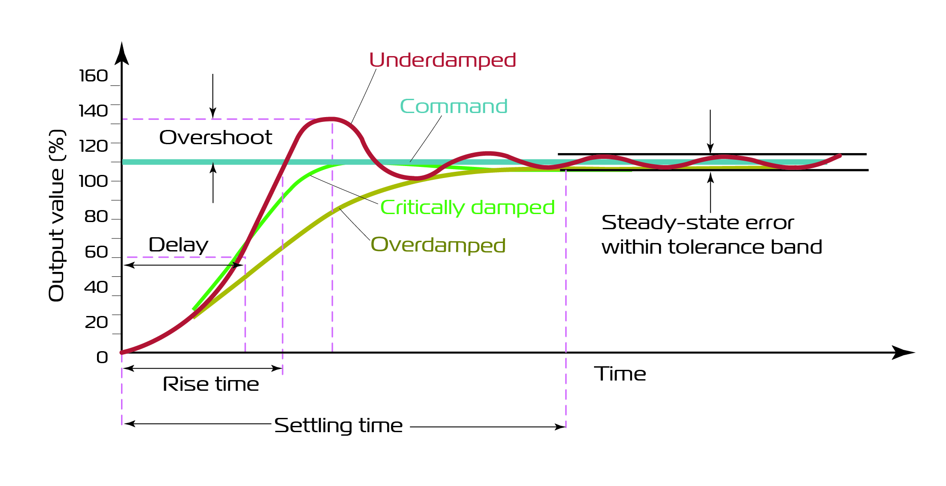
PID controller’s typical Reponses

Slide 5
Proposed Solution
Regression model predicts PID gains
Inputs: Error, Integral Error, Derivative Error
Outputs: Kp, Ki, Kd
Model trained using AWS Sage Maker

Slide 6
Machine Learning Pipeline
Data generation
Data preprocessing
Model training
Model evaluation
Cloud deployment

Slide 7
Benefits
Automatic controller tuning
Reduced engineering effort
Improved system stability
Supports Industry 4.0 automation

Slide 8
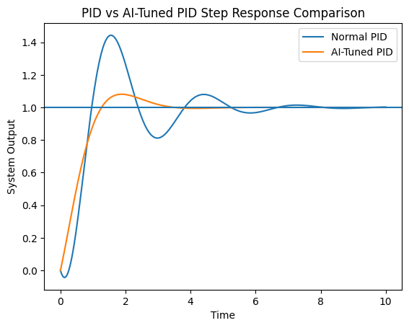
PID vs AI-Tuned PID Performance

Slide 9
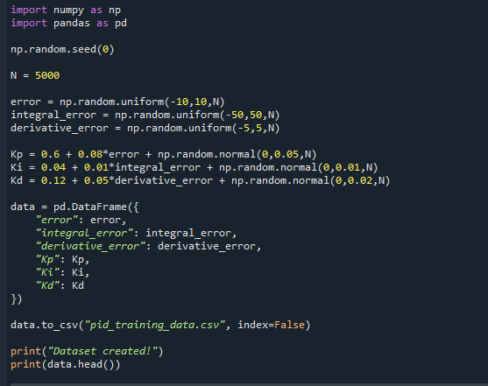
Dataset Generation

Slide 10
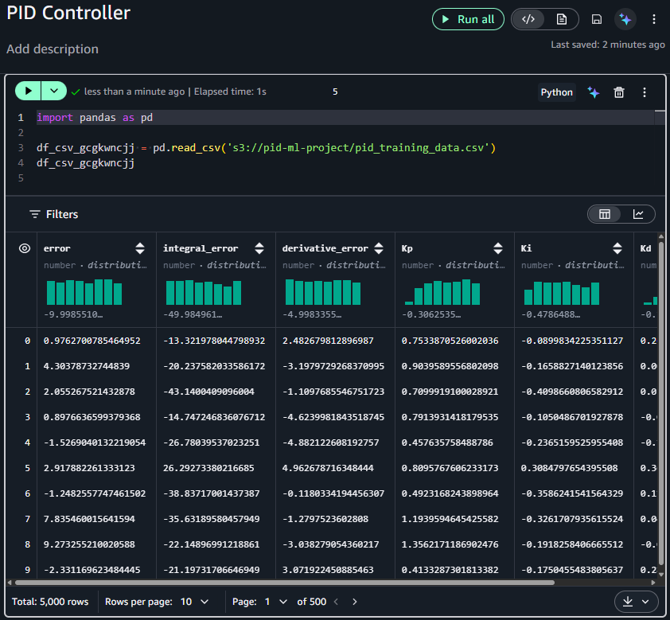
AWS S3 – Dataset Upload

Slide 11
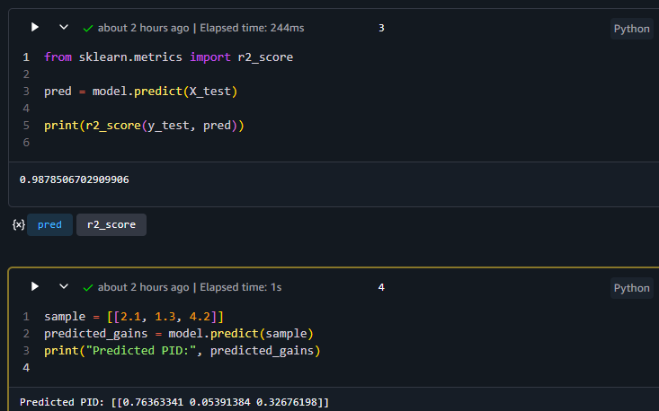
AWS Sage Maker – Model Prediction Output

Slide 12
Conclusion
Machine learning enhances traditional PID control
AWS cloud enables scalable model training
Adaptive control systems are future of smart manufacturing

